Slide 1
ENERGY DRINKs
Made by Savonin Maxim ET-211

Slide 2
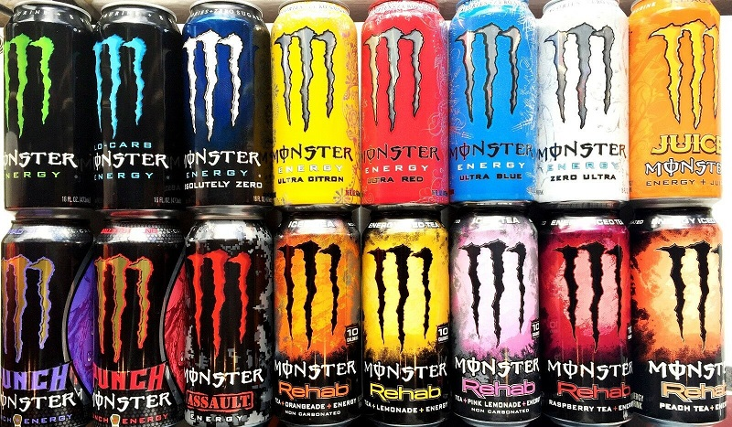
INTRODUCTION
For the past 25 years in Russian shops, you can see energy drinks in stories, the pros and of which we will talk about today

Slide 3

Purpose
Talk about the history of energy drinks
Talk about the benefits of energy drinks
Learn about scientist opinion
Talk about the cons of energy drinks
Find out Why people love energy drinks?
Interesting facts about energy drinks

Slide 4
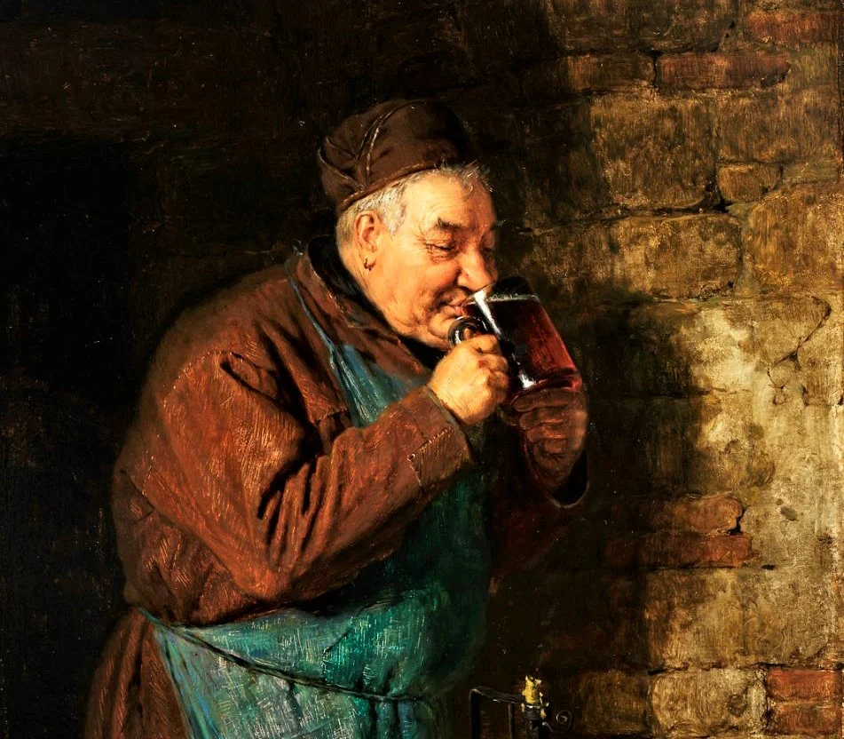
Monks and energy drinks
Energy drinks first appeared in twelfth-century Germany in monasteries. Of course, their taste is difficult to compare with our drinks.

Slide 5
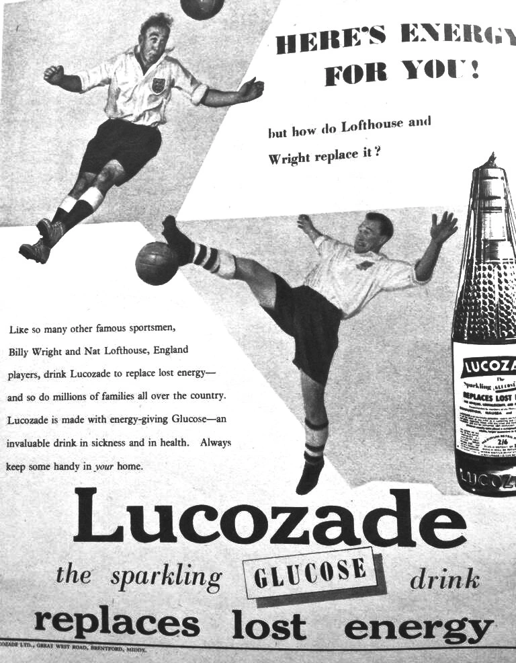
Energy drinks in 20th century
Lucozade can be called the first energy drinks of our time. It first appeared in England and was used for medical purposes like other energy drinks of that time.

Slide 6


Second world war
Also energy drinks were used during the second world war, sometimes adding drugs to them for the morale of the soldiers

Slide 7
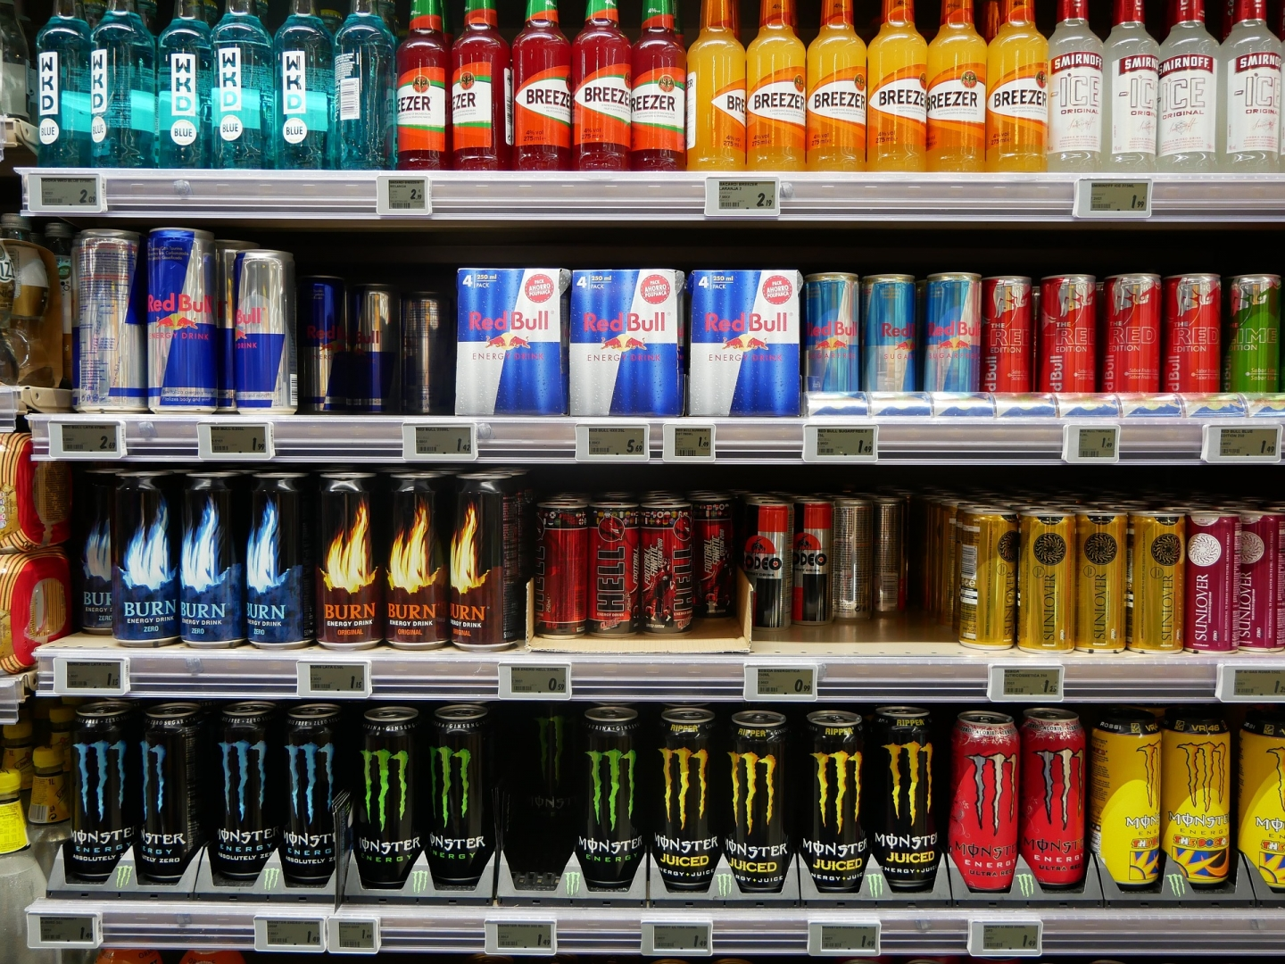
Our days
In our days Energy drinks have become commonplace these days. You can find them in any grocery store. People drink them for taste and energy.

Slide 8

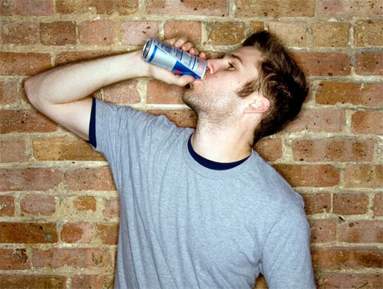
Benefits of energy drinks
Uplifting root
Increase of vigor
Better than coffee
Contains vitamins
It’s tasty and cheap

Slide 9
Opinion of scientists

